Slide 1

Emotion Based Ambiance and Music Regulation using Deep Learning

Slide 2
Introduction
In today’s hyper active world full of stress and pressure, mental and emotional health is becoming important factors in maintaining a person’s well-being.
But with the ever increasing work and social load, people don’t have enough time to take care of themselves, especially their mental health.
There are enormous amount of studies that showcase that the ambient lighting and music have a major impact on the mood.
So, our solution to is to track the persons emotions using a network of cameras and set the lighting theme, music and ambiance in accordance to the mood of person.

Slide 3
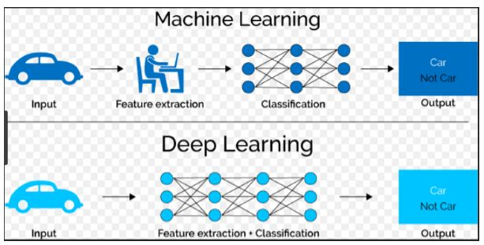
Machine Learning Vs Deep Learning
In Machine learning, most of the applied features need to be identified by an expert and then hand-coded as per the domain and data type.
For example, features can be pixel values, shape, textures, position and orientation. The performance of most of the Machine Learning algorithm depends on how accurately the features are identified and extracted.
Deep learning algorithms try to learn high-level features from data. This is a very distinctive part of Deep Learning and a major step ahead of traditional Machine Learning. Therefore, deep learning reduces the task of developing new feature extractor for every problem. Like, Convolutional NN will try to learn low-level features such as edges and lines in early layers then parts of faces of people and then high-level representation of a face

Slide 4
Working of system
A camera connected to a microprocessor captured the feed.
As soon as the face is detected, the algorithm detects the mood of person based on facial expressions.
Based on the detected mood, a score is assigned. Lower the score, sadder is the person. Now based on this score, the system plays music and changes lighting conditions of room.
This ambiance and lighting conditions are regulated to enhance the mood of person.
So, if the person is sad, we aim to enhance his/her mood. And if the person is already happy, we aim to keep it boosted.

Slide 5
Findings and comparison
We went through various works, which are already published and are similar to our technology.
We have found that some of them focus only on mood detection, some had used different algorithms and some of them did not detect as many moods as our algorithm does.
One of the work use same algorithm and classified same number of moods like our algorithm did, but their results in terms of accuracy and loss we not as good, as compared to our model.
We have provided the results below:

Slide 6
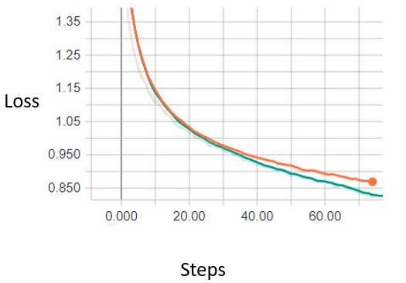
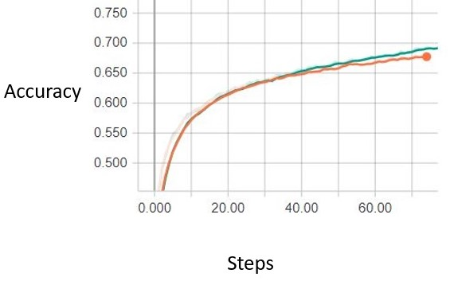
Findings and comparison
The green line is accuracy of our model, and orange line is accuracy of other model, it is clearly seen how our model has a higher accuracy score.
Similarly we compare loss and prove, our model reaches less loss values, indicating better performance.

Slide 7
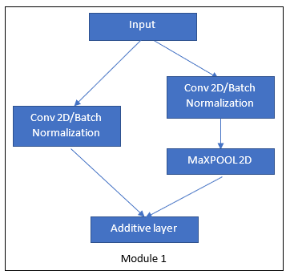
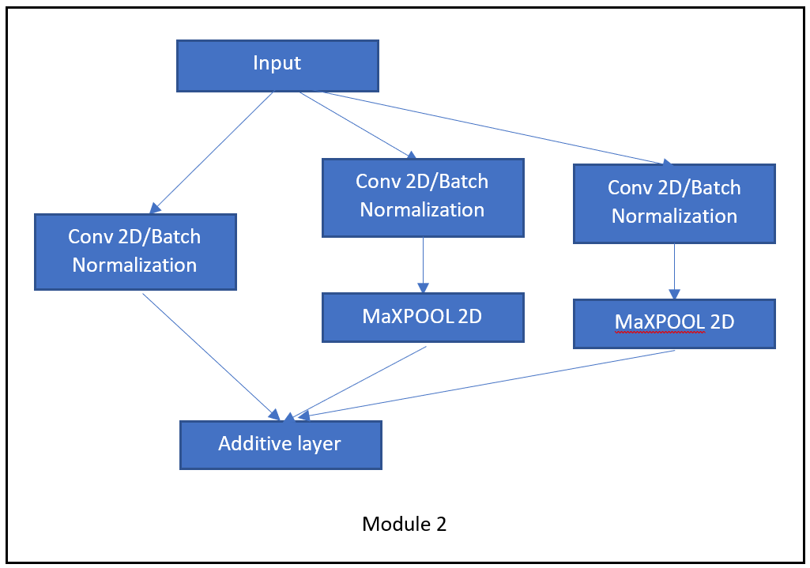
Our architecture
Our model feed with the image of dimensions 64/64 with only grayscale, which goes into network which feeds it to a conv_2d network after which it goes through batch normalization and then fed to an activation layer.
The output of this layer is fed into module 1, which is connected to module 2 and then again to module 1 to module 2 and then finally the output is fed to our exit layer. Consisting of conv 2D followed by Global avg pooling and then a softmax activation layer.

Slide 8
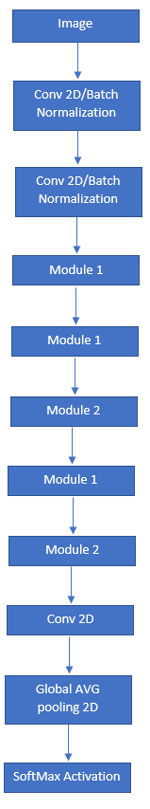
Our model architecture

Slide 9
Conclusion
By leveraging the power of Machine learning to train on the FER 2013 database to generate a model to detect emotions, we propose our system.
The entire system can be summarized as a camera collecting live feed, identification of mood and regulation ambiance and music conditions.

